Slide 1

Ridge Regression
Dr. Debajyoti Biswas

Slide 2
Regression
Regression
Simple Linear Regression
Ridge Regression
LASSO Regression
Elastic Net (Ridge+ LASSO) Regression

Slide 3
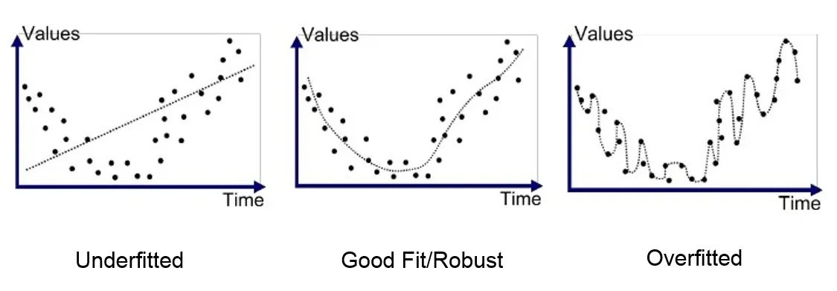
overfitting
Overfitting occurs when the model works very well with the training dataset, but on the testing dataset, it fails (meaning that the accuracy of training data is >90% and testing data is < 65%).
It is also called a model with high variance. A possible solution is to use the correct regression technique, that is Ridge and Lasso

Slide 4
Multicolinearity
A situation in which more than two independent variables in a multiple regression model are highly linearly related
In this situation, the coefficient estimates of the multiple regression may change erratically in response to small changes in the data or the procedure used to fit the model
If there is no multicollinearity present in the data then there may be no need to perform ridge regression in the first place. Instead, we can perform ordinary least squares regression

Slide 5
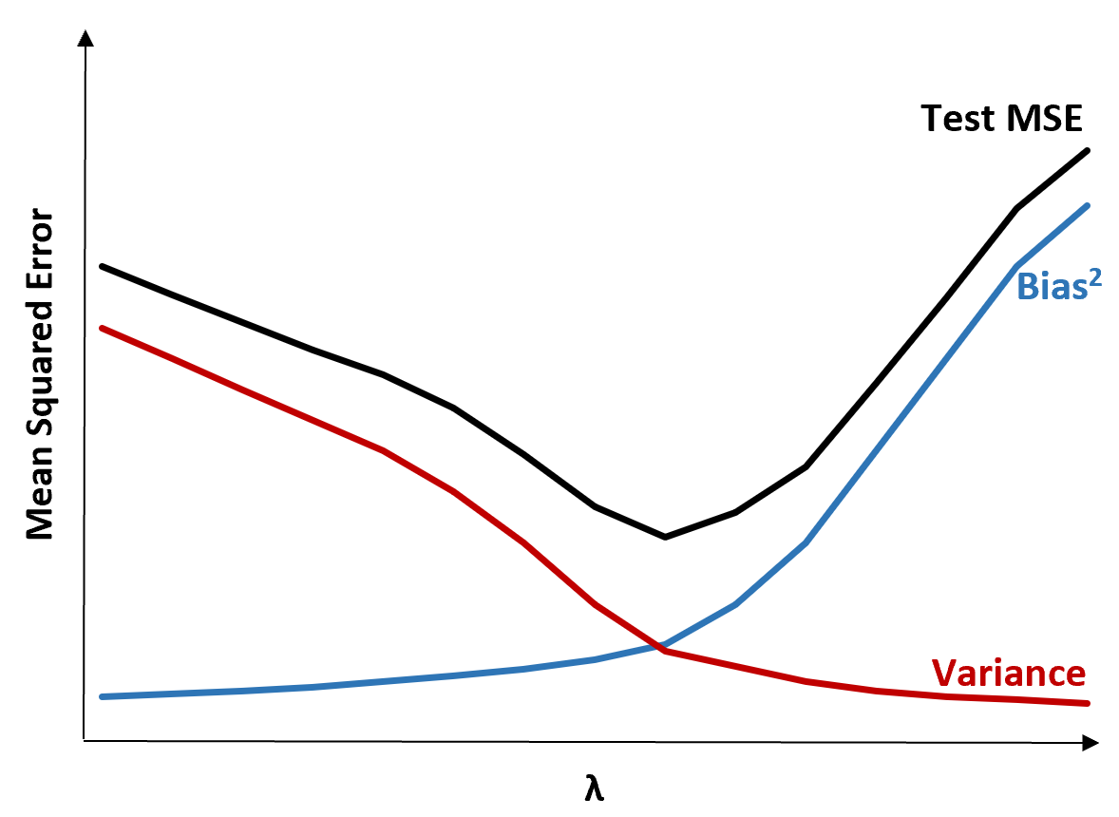
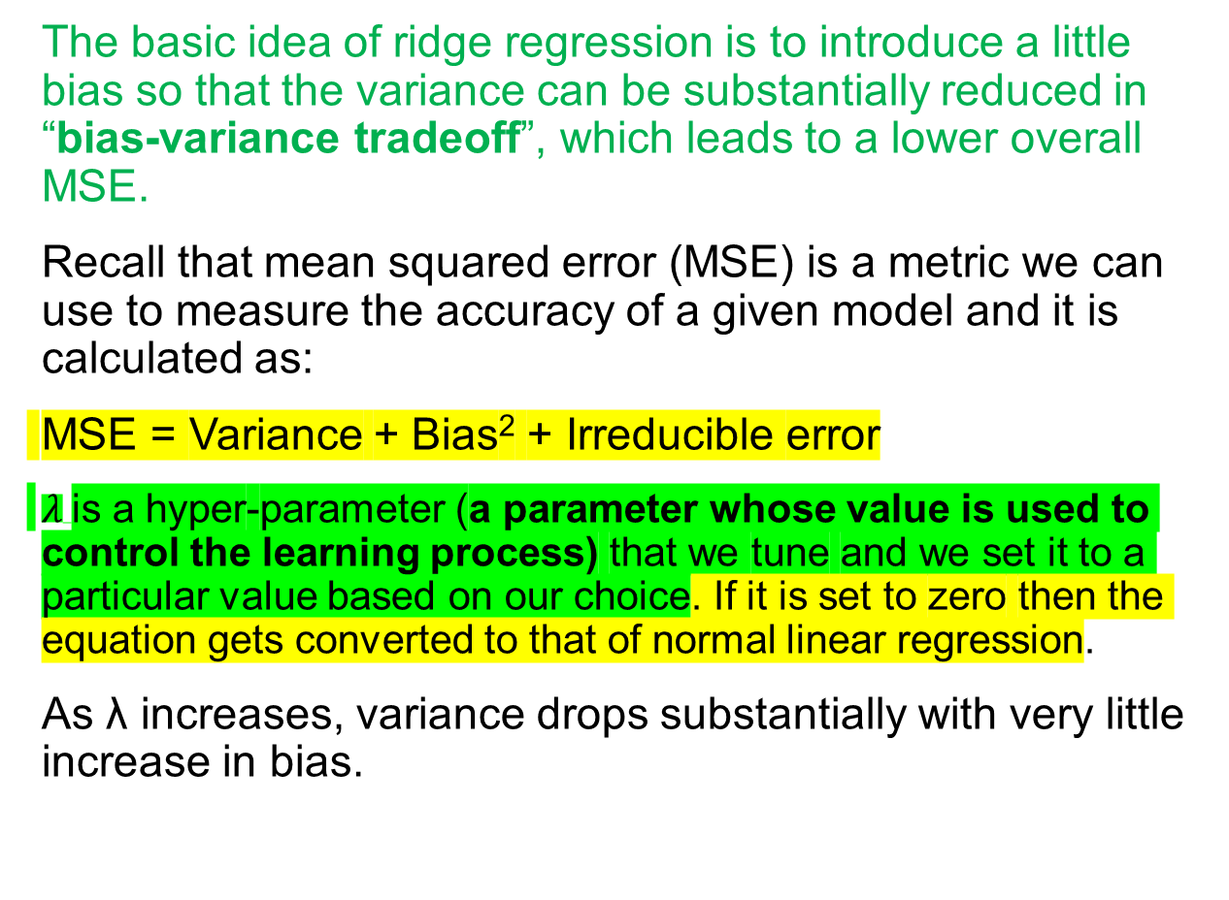
Ridge Regression
The basic idea of ridge regression is to introduce a little bias so that the variance can be substantially reduced in “bias-variance tradeoff”, which leads to a lower overall MSE.
Recall that mean squared error (MSE) is a metric we can use to measure the accuracy of a given model and it is calculated as:
MSE = Variance + Bias² + Irreducible error
$λ$is a hyper-parameter (a parameter whose value is used to control the learning process) that we tune and we set it to a particular value based on our choice. If it is set to zero then the equation gets converted to that of normal linear regression.
As λ increases, variance drops substantially with very little increase in bias.
MSE is lowest when we choose a value for λ that produces an optimal tradeoff between bias and variance.

Slide 6
Pros and cons of ridge regression
The biggest benefit of ridge regression is its ability to produce a lower test mean squared error (MSE) compared to least squares regression when multicollinearity is present.
However, the biggest drawback of ridge regression is its inability to perform variable selection since it includes all predictor variables in the final model.
Introduction to Ridge Regression - Statology

Slide 7
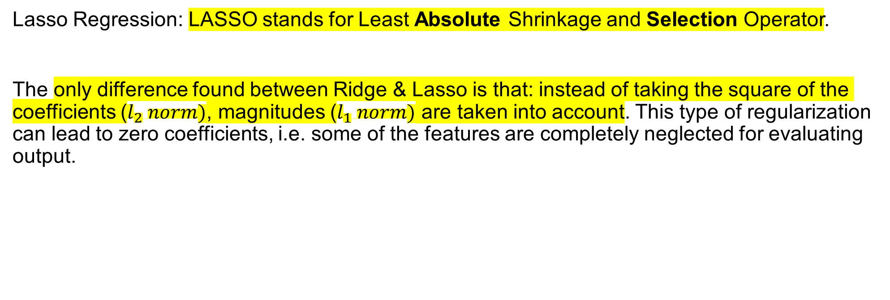
LASSO Regression
Lasso Regression: LASSO stands for Least Absolute Shrinkage and Selection Operator.
The only difference found between Ridge & Lasso is that: instead of taking the square of the coefficients ($l_{2} norm)$, magnitudes ($l_{1} norm)$ are taken into account. This type of regularization can lead to zero coefficients, i.e. some of the features are completely neglected for evaluating output.

Slide 8
Rest of the slides in this ppt are for further reading only

Slide 9
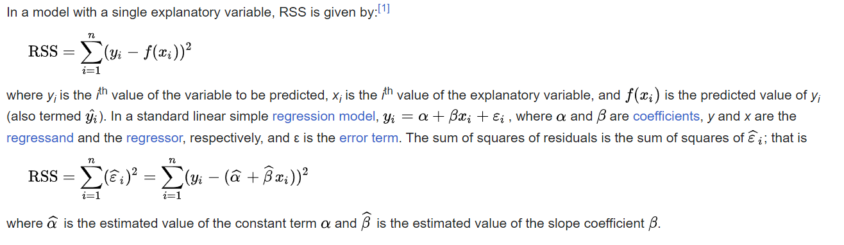
Residual sum of squares (rss)
Residual sum of squares - Wikipedia

Slide 10
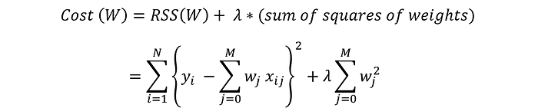
regularization
Regularization is the process that regularizes or shrinks the coefficients towards zero
Regularization discourages learning a more complex or flexible model to prevent overfitting
RSS(Residual Sum of Squares) measures the amount of error staying between the regression function and the data set. It is a measure of the amount of statistical variance present in the dataset
Ridge & Lasso Regression. Solving overfitting and underfitting… | by Deep Patel | Medium

Slide 11
Error=True Value-Predicted value
For a linear regression model, Error=True value-Predicted value from Linear Regression
Linear Regression → y=mx+c
This is true for ideal case. Real life has errors
Error=y-(mx+c) or True value y- Predicted value (mx+c)
RSS=[y-(mx+c)]^2 or for many cases, Sum of [yi-(mxi+c)]2
Cost=Cost of utilizing a ML model=Error+Some parameter * The coefficients of model

Slide 12
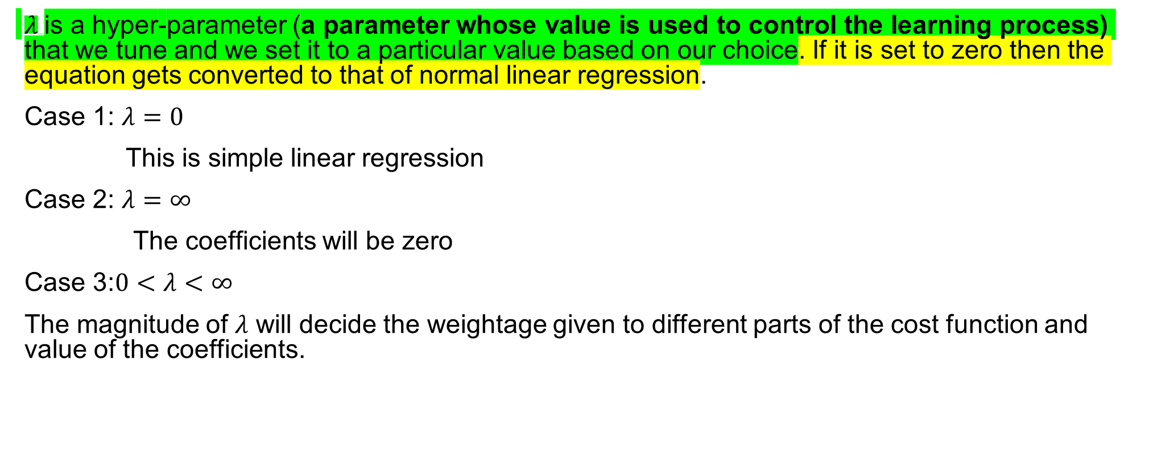
regularization
$λ$is a hyper-parameter (a parameter whose value is used to control the learning process) that we tune and we set it to a particular value based on our choice. If it is set to zero then the equation gets converted to that of normal linear regression.
Case 1: $λ=0$
This is simple linear regression
Case 2: $λ=∞$
The coefficients will be zero
Case 3:$0<λ<∞$
The magnitude of $λ$ will decide the weightage given to different parts of the cost function and value of the coefficients.

Slide 13
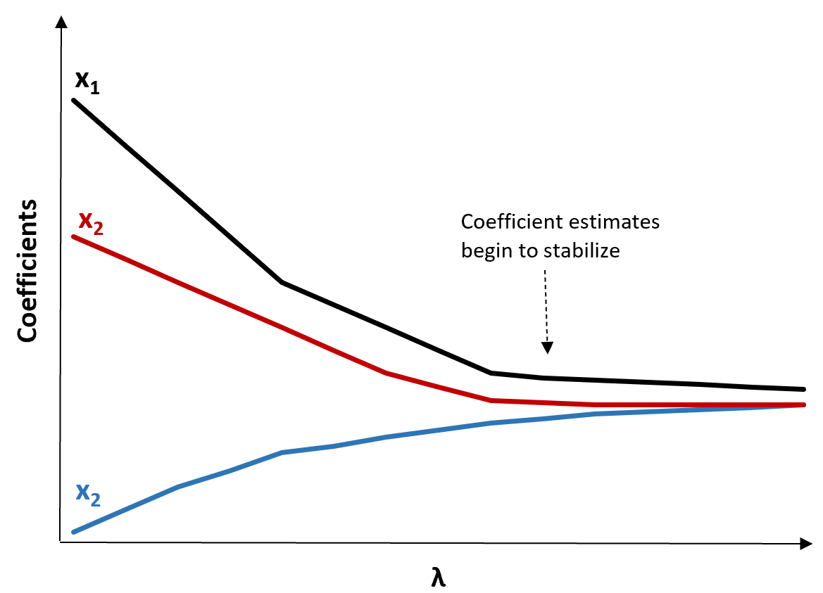

Ridge trace
This is a plot that visualizes the values of the coefficient estimates as λ increases towards infinity.
Typically we choose λ as the value where most of the coefficient estimates begin to stabilize
Another way to choose λ is to simply calculate the test MSE of each model with different values of λ and choose λ to be the value that produces the lowest test MSE
$$x_{3}$$
Introduction to Ridge Regression - Statology

Slide 14
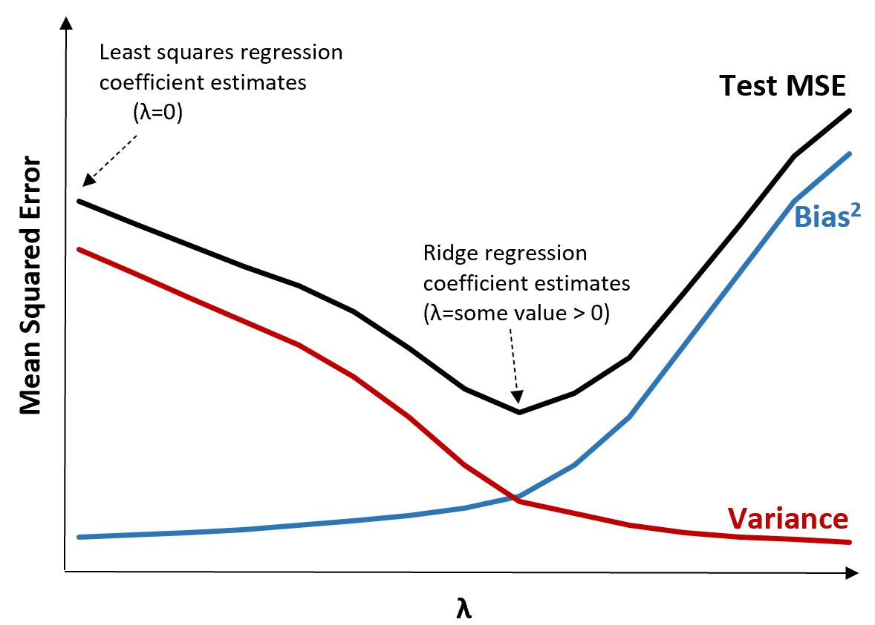
Ok, so what?
This means the model fit by ridge regression will produce smaller test errors than the model fit by least squares regression.

Slide 15
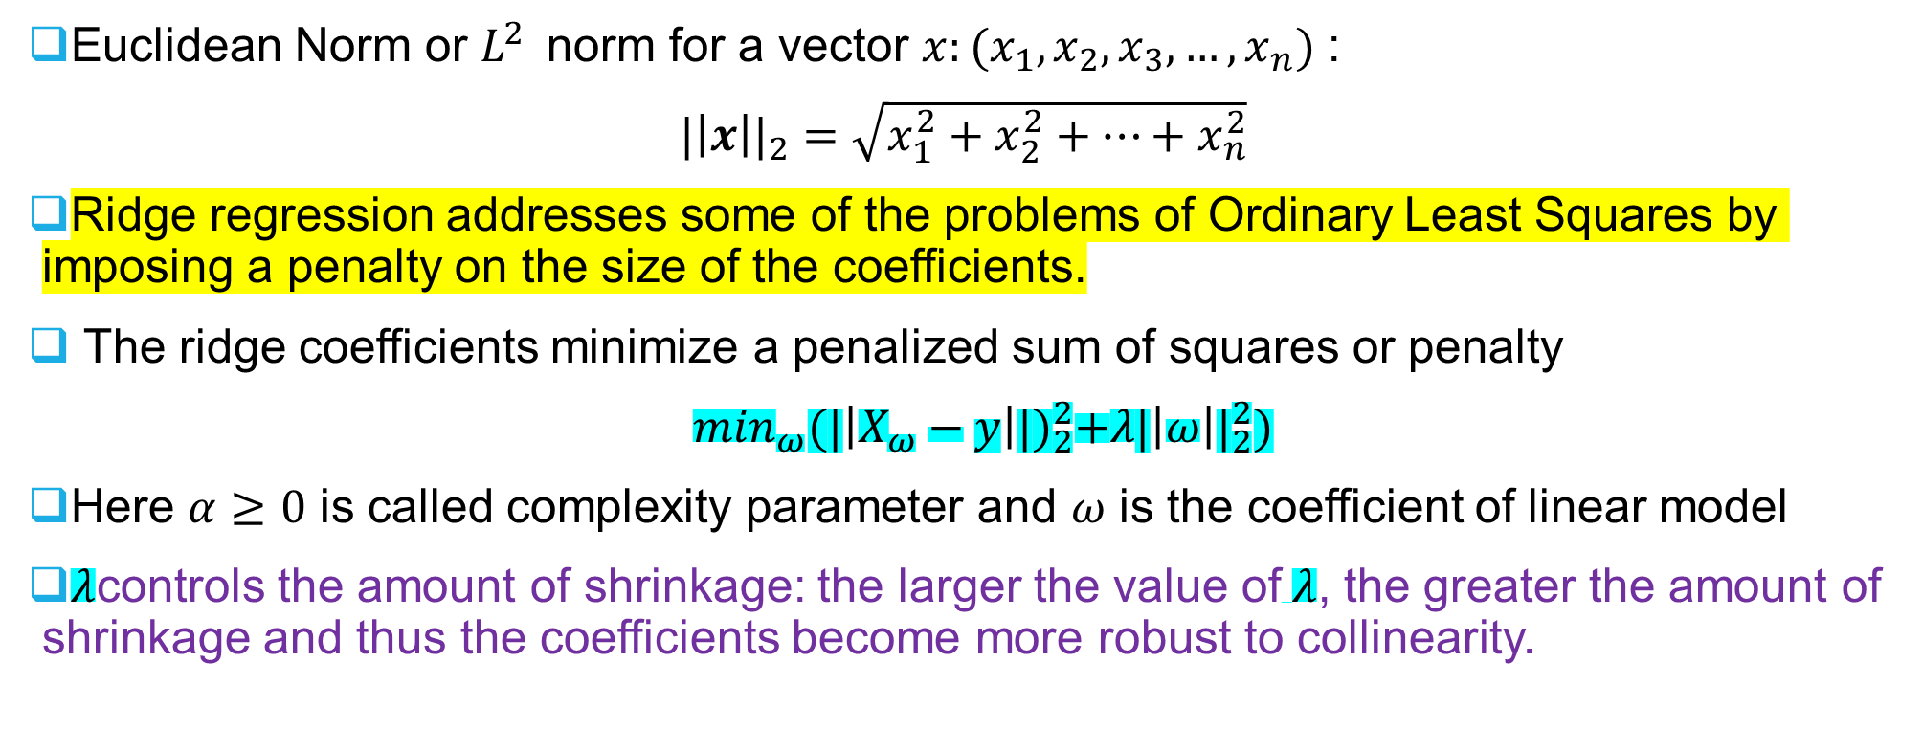
Euclidean norm and penalty for ridge regression
Euclidean Norm or $L^{2}$norm for a vector $x:(x_{1},x_{2},x_{3},…,x_{n})$ :
${|\left|x\right||}_{2}=\sqrt{x_{1}^{2}+x_{2}^{2}+…+x_{n}^{2}}$
Ridge regression addresses some of the problems of Ordinary Least Squares by imposing a penalty on the size of the coefficients.
The ridge coefficients minimize a penalized sum of squares or penalty
$\min_{ω}{(|\left|X_{ω}−y\right||)}_{2}^{2}+{λ|\left|ω\right||}_{2}^{2})$
Here $α≥0$ is called complexity parameter and $ω$ is the coefficient of linear model
$λ$controls the amount of shrinkage: the larger the value of$λ$, the greater the amount of shrinkage and thus the coefficients become more robust to collinearity.
1.1. Linear Models — scikit-learn 1.3.1 documentation
Ridge regression - Wikipedia

Slide 16
Ridge regression is basically minimizing a penalized version of the least-squared function. The penalizing shrinks the value of the regression coefficients.
Despite the few data points in each dimension, the slope of the prediction is much more stable and the variance in the line itself is greatly reduced, in comparison to that of the standard linear regression

Slide 17
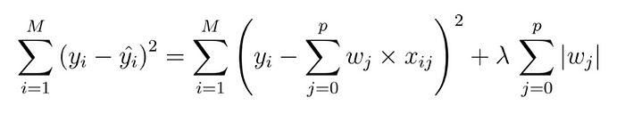
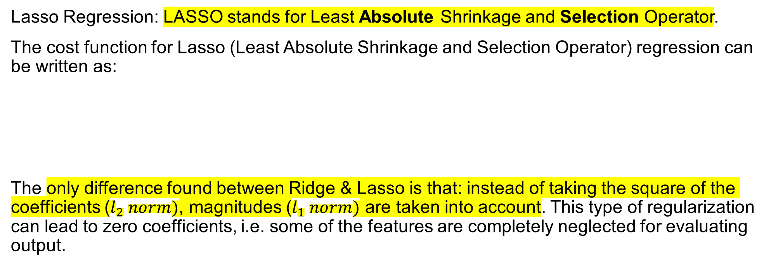
LASSO Regression
Lasso Regression: LASSO stands for Least Absolute Shrinkage and Selection Operator.
The cost function for Lasso (Least Absolute Shrinkage and Selection Operator) regression can be written as:
The only difference found between Ridge & Lasso is that: instead of taking the square of the coefficients ($l_{2} norm)$, magnitudes ($l_{1} norm)$ are taken into account. This type of regularization can lead to zero coefficients, i.e. some of the features are completely neglected for evaluating output.

